Slide 1
Leveraging AI for Faster and Efficient Clinical Trials with a Focus on High Drop Rate

Slide 2
Agenda
Introduction | Project Summary | Why Chose the Project
Group Name and Members Intro
How you worked on the project
Issues Experienced and Resolution
Key Learnings
Results & Possible Next Steps
Questions

Slide 3

Introduction Our project explores how AI can enhance clinical trials by predicting patient dropout risks, enabling proactive intervention and improving trial success rates. Summary of What the Project is About Clinical trials are a cornerstone of medical research, yet they often face significant challenges such as long durations, high costs, and a frequent issue of participant dropout. These dropouts not only delay the progress of promising treatments but also increase operational burdens and compromise the integrity of the data. IN this project, We built an AI model that predicts the likelihood of participants dropping out of clinical trials. It analyzes multiple patient and trial-related factors to help researchers act early. This project aims to explore how Artificial Intelligence (AI) can improve clinical trial efficiency by: Predicting dropout risks Identifying root causes Providing smart recommendations to retain participants Why We Chose the Project Clinical trials often face delays and inefficiencies due to participant dropout. By leveraging AI, we aimed to provide a data-driven solution to reduce trial failures and costs.

Slide 4



Meet the team
MARY ADESANYA DIPTI KULKARNI SONIA MERZOUD
WAIPRACTICE GROUP 2

Slide 5






How WE worked on the project
Slack – Team communication and organizing group meetings
Google Colab – Writing and running Python code directly in the browser
Google Docs – Sharing notes, research insights, and documentation
Drive – Store and manage Colab notebooks and other project files
GitHub – Hosting datasets, version control, and collaborating on code
PyCharm – Advanced debugging with a graphical interface

Slide 6
Issues Experienced and Resolution

Slide 7

Issues Encountered
Listed below are some of the challenges faced during the project implementation;
Data Quality Issues
Model Accuracy
Interpreting AI Outputs
Setting up the Python environments to handling missing packages and encoding data
Resolution
The encountered issues were resolved using below approach;
Data Quality Issue was Resolved with thorough Cleaning and Preprocessing
Model Accuracy issue was Improved by tuning Parameters and Cross-validation
Enhanced AI Outputs through interdisciplinary discussions
Iinstalling necessary libraries (pandas, scikit-learn), using tools like LabelEncoder for categorical features.

Slide 8

KEY LEARNINGS
AI Enables Early Risk Detection
Proactively mitigates participant dropout
Data Is Central
High-quality data critical to model success
Collaboration Bridges Gaps
Teamwork enhances interpretation and application
Gained skills in data preprocessing, model training, and evaluation
Understanding of clinical trial dynamics
Learned to deploy AI in a practical and structured way

Slide 9
FINAL RESULT

Slide 10
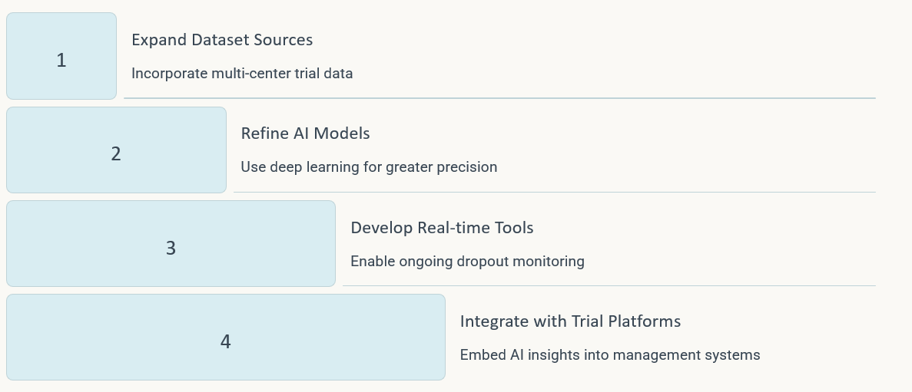
NEXT STEPS

Slide 11
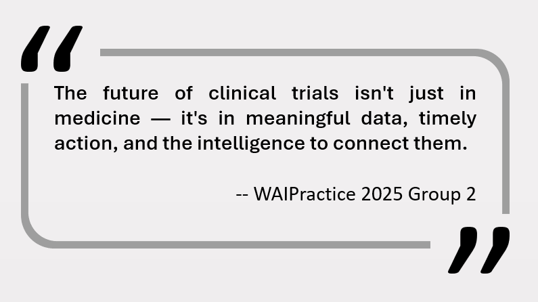

Slide 12
THANK YOU

Slide 13
questions?

